Slide 1


Slide 2

Our Code of Conduct
Be welcoming and respectful
Be open to all questions and viewpoints
Be understanding of differences
Be kind and considerate to others
Be aware of others
Be friendly and patient
Microsoft is dedicated to empowering every person and every organization on the planet to achieve more. This includes Microsoft Reactor events where we seek to provide a respectful, friendly, professional experience for everyone, regardless of gender, sexual orientation, physical appearance, disability, age, race or religion. We do not tolerate any behaviour that is harassing or degrading to any individual, in any form. Individuals are responsible for knowing and abiding by these standards. We encourage everyone to assist in creating a welcoming and safe environment.
Notes:
Before we get into it a quick word on our code of conduct.
The key thing to take out here is to be respectful of other people’s views, understanding of differences and kind and considerate in the way you engage.
The chat will be open throughout and we do encourage you all to participate.
And with that, I will hand over to Ben.

Slide 3



Speaker Bio
Hadeel Shubair
Goal: To take you on a journey in Data Analytics and share my knowledge with you!
Hadeel Shubair
v-hshubair@microsoft.com

Slide 4
Learning Objectives
Data Science Lifecycle – Overview
Importance of data preparation
Data Cleaning & Preprocessing steps
Example - walkthrough

Slide 5

Data Science
Definition:
- Data science is the domain of study that deals with vast volumes of data using modern tools and techniques to find unseen patterns, derive meaningful information, and make business decisions. Data science uses complex machine learning algorithms to build predictive models.
Goal:
- To construct the means for extracting business-focused insights from data.
- This requires an understanding of how value and information flows in a business, and the ability to use that understanding to identify business opportunities.

Slide 6

Data science is an iterative process between:
The knowledge and understanding of what is today
Data that has been collected
Questions that are being asked

Slide 7
Data Science lifecycle

Slide 8
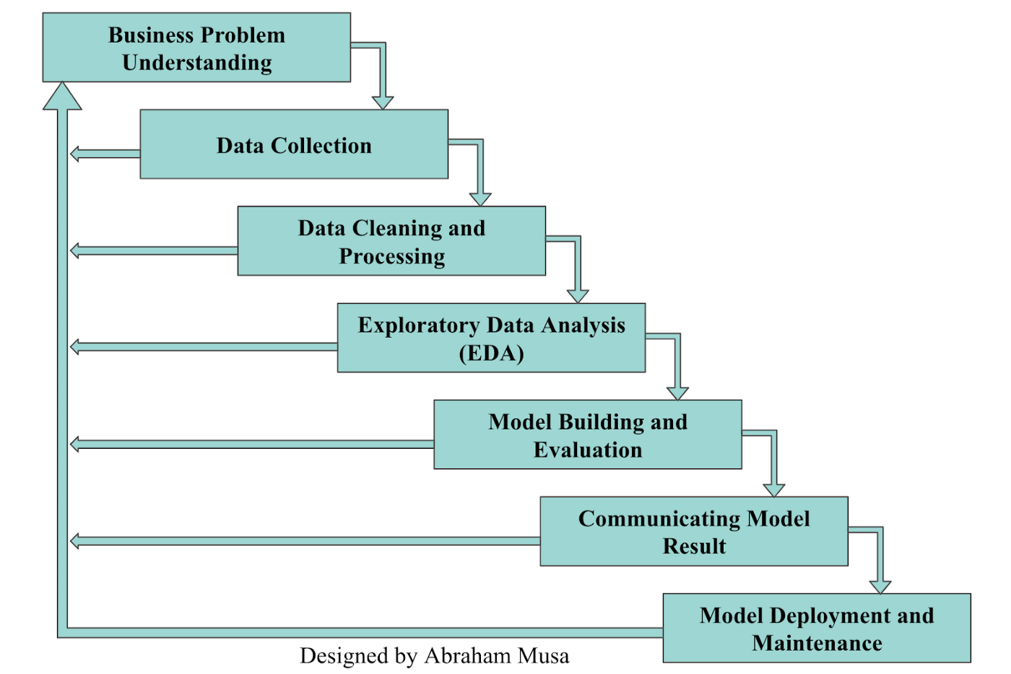
Data Science lifecycle

Slide 9
Many organizations and individuals talk about data science projects and products, but only a handful understand the steps involved in building a data science product or model. One thing I’ve come to discover so far is that only a few organizations have the appropriate infrastructure for data science. The majority of modern enterprises need to undergo significant transformations to benefit from data science.

Slide 10
Let’s explore each stage in the data science lifecycle

Slide 11
1) Understand the Business Problem/ Define the objective
Understand the objective, the purpose:
Why are you doing this? What outcome do you want from it?
What problems are you trying to solve?
Which parts of your business do you want more information about? Are you trying to solve an existing problem or predict how your company will perform based on determined factors?
Why?
Clearly defining your goals will help guide the rest of the analysis process.
You need to be able to transform the business needs into data science questions and actionable steps
After asking the required questions to the company stakeholders or clients, we move to the next process which is known as data collection.

Slide 12
2) Data Collection
The next step after problem understanding is to collect the right set of data.
Data collection is essential, and it’s practically challenging or (nearly impossible) to build a good model without quality data or the mechanism to collect the data.
How?
Through web scraping with Python
With the emergence of modern technologies like web scraping, cloud data collection tools and web APIs; database systems, and tools like SQL, Python, R, Beautiful Soup, Scrapy, Spark, Apache, etc, you can extract valuable data from anywhere at any time.

Slide 13
Resources to find datasets:
Kaggle - Open datasets
Dataset Search (google.com)
Azure Open Datasets - Microsoft Docs
Papers With Code - Datasets
Data.world - Open datasets
DataHub.io - Datasets

Slide 14
3) Data Cleaning & Preprocessing
We've collected our data, now we want to prepare it (clean & format it)
Data cleaning includes removing and replacing junk data, filling in some gaps if present
This stage helps us gain a better understanding of the data and prepares it for further evaluation
Why?
Most datasets have errors – missing values, duplicates, unwanted data points
Clean data -> reliable statistics -> improved decision-making
Fun fact!
Data preparation is the most time-consuming process, accounting for up to 80-90% of the total project duration, and this is the most crucial step throughout the entire life cycle.

Slide 15
4) Exploratory Data Analysis (EDA)
At this point, you have a wealth of data, you’ve been able to clean and process the data to be as organized as possible.
What’s next?
It’s time to explore our dataset and deeply inspect all the data features, data properties, uncover hidden patterns, gain intuition about the data, highlight most significant factors, figure out how to handle each feature.. etc.
This entire process is referred to as Exploratory data analysis (EDA). EDA analyzes datasets to summarize characteristics often using statistical graphics and other data visualization methods.
This step is important because it helps us explore and understand what is in the data, and make sense of it

Slide 16
5) Model Building and Evaluation
This stage is all about doing the actual modelling of the data. Based on the problem we are trying to solve, the most suitable model for the dataset will be selected
Specific techniques are used in building, and evaluating our model:
- Splitting dataset into train & test sets:
Training set – to build predictive models and evaluate your model's performance on unseen data points (making the model learn)
Testing set – used to test the accuracy of the model after completing the training
- Using evaluation metrics to examine how well your model works (accuracy, precision, etc)
- Based on evaluation results, you may need to tweak the model’s parameters to ensure that it generalizes well and can work well when exposed to previously unseen data. This process is known as hyperparameter tuning.

Slide 17
6) Communicating Model Results
After building and evaluating the model, you need to communicate the model results and present your findings to stakeholders
Data visualizations: translating information into a visual context - For example: graphs, charts, tables, boxplots, scatter plots, bar charts, pie charts, etc.
Important:
It is critical to have storytelling skills to show stakeholders how a model helps address the business problems identified in the first phase of the life cycle

Slide 18
7) Model Deployment and Maintenance
After communicating your findings and results, the next step is to deploy the actual model
”No machine learning model is useful unless it’s deployed to production.”
Now, we can see that we've gone through the basic steps in a data science lifecycle, and have transformed our business needs to actionable insights

Slide 19
Today, we will focus on the first stage in the Data Science lifecycle together – Data cleaning & preprocessing

Slide 20
Intro
Real-world data is messy. You'll likely need to combine several data sources to get the data you actually want. The data from those sources will be incomplete and the data likely won't be formatted exactly the way you want it for your analysis.
For these reasons, most data scientists will tell you that about 80-90% of any project is spent just getting the data into a form that is ready to use for analysis.
Data scientists agree that better data is even more important than the most powerful algorithms. This is because machine learning models only perform as well as the data they’re trained on.

Slide 21
What is Data Cleaning?

Slide 22
What is Data Cleaning?
The process of fixing or removing incorrect, corrupted, incorrectly formatted, duplicate, or incomplete data within a dataset.
When combining multiple data sources, there are many opportunities for data to be duplicated or mislabeled. If data is incorrect, outcomes and algorithms are unreliable, even though they may look correct.
There is no one absolute way to prescribe the exact steps in the data cleaning process because the processes will vary from dataset to dataset. But it is crucial to establish a template for your data cleaning process so you know you are doing it the right way every time.
In short, data cleaning involves removing data that does not belong in your dataset

Slide 23
“Garbage in, Garbage out”
If you start with bad data (garbage), you’ll only get “garbage” results.

Slide 24
What is involved in data cleaning?
Removing duplicates or irrelevant observations
Fixing structural errors
Filtering/dealing with unwanted outliers
Handling missing data/NULL values
Normalization
Converting categorical into numerical values
Basic validation
Why?
Having clean data will ultimately increase overall productivity and allow for the highest quality information in your decision-making.
How?
While the techniques used for data cleaning may vary according to the types of data stored, we will be walking through a number of basic steps to help you get a clean & neat dataset

Slide 25
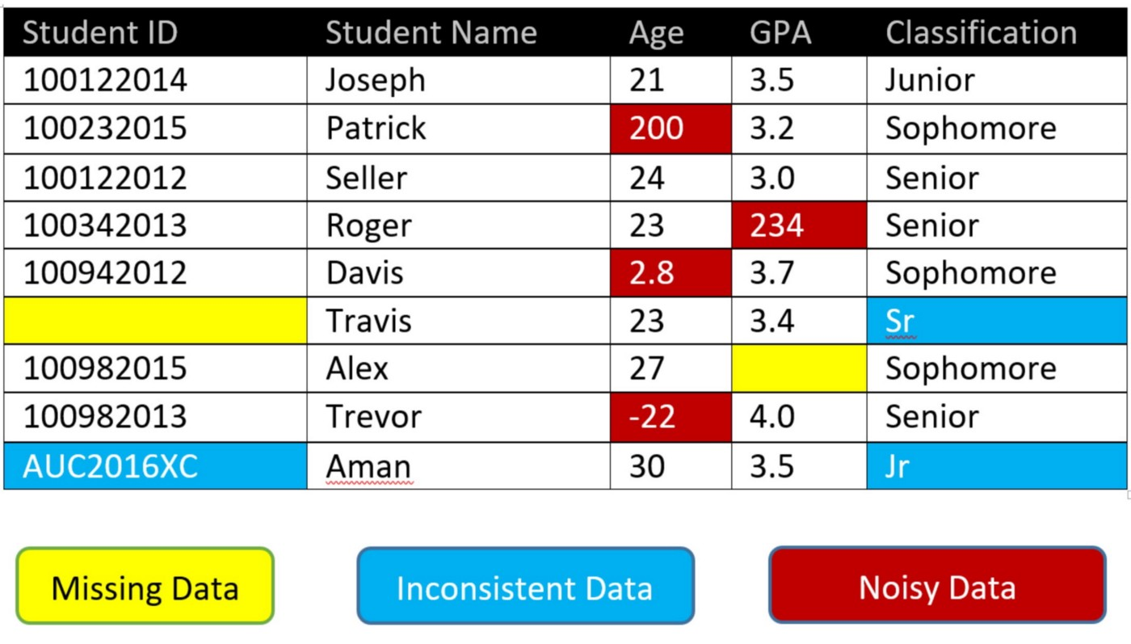

Slide 26
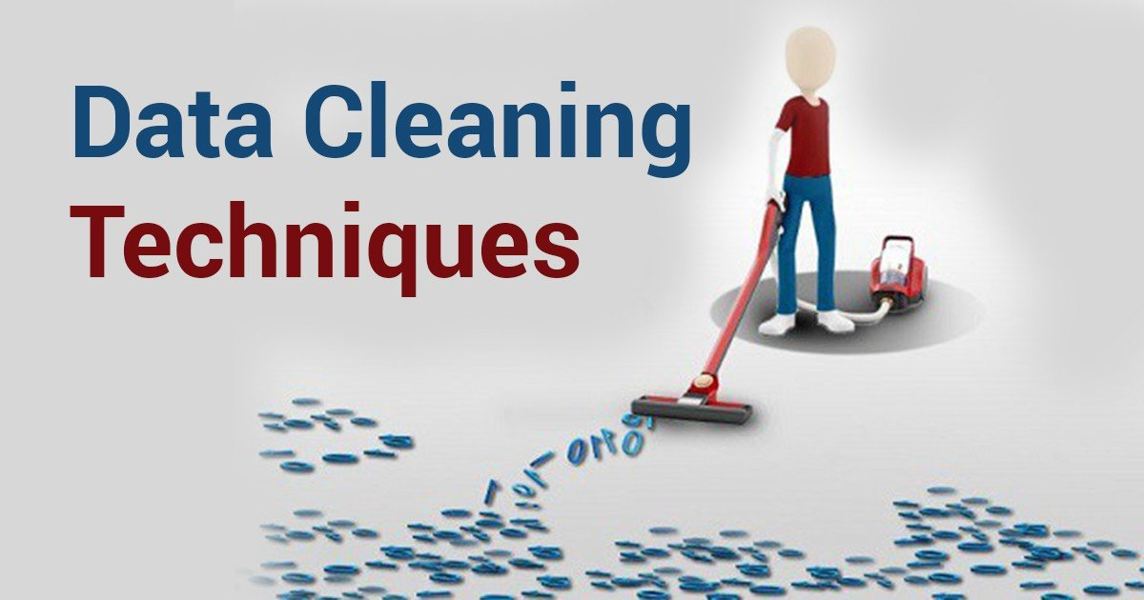

Slide 27
Step 1: Remove duplicates or irrelevant observations
Every dataset could consist of unwanted observations, such as duplicates or irrelevant observations.
Duplicate observations will happen most often during data collection. When you combine data sets from multiple places, scrape data, or receive data from clients or multiple departments, there are opportunities to create duplicate data.
Irrelevant observations are when you notice observations that do not fit into the specific problem you are trying to analyze.
Consider removing things like hashtags, URLs, emojis, HTML tags, etc., unless they are necessarily a part of your analysis.
Example:
Some users click the enter button many times. The form’s data gets entered many times, so remove duplicate values if found.
If you want to analyze data regarding millennial customers, but your dataset includes older generations, you might remove those irrelevant observations. This can make analysis more efficient and minimize distraction from your primary target—as well as creating a more manageable dataset.

Slide 28
Step 2: Fix structural errors
Structural errors include things like misspellings, typos, strange naming conventions, incorrect capitalization, incorrect word use, etc.
These inconsistencies can cause mislabeled categories or classes and can affect analysis because most machine learning applications wouldn’t recognize the mistakes and your analyses would be skewed
Examples:
If you’re running an analysis on different data sets – one with a ‘women’ column and another with a ‘female’ column, you would have to standardize the title. Similarly, things like dates, addresses, phone numbers, etc. need to be standardized, so that computers can understand them.
You may find “N/A” and “Not Applicable” both appear, but they should be analyzed as the same category.
"Dubai" and "dubai"

Slide 29
Step 3: Filter unwanted outliers
An outlier is a piece of data that sits far away from the rest of our data - think of it as an unwanted value which is not fitting in datasets
Often, there will be one-off observations where they do not appear to fit within the data you are analyzing. If you have a legitimate reason to remove an outlier, like improper data-entry, doing so will help the performance of the data you are working with. However, sometimes it is the appearance of an outlier that will prove a theory you are working on.
Remember: just because an outlier exists, doesn’t mean it is incorrect. This step is needed to determine the validity of that number. If an outlier proves to be irrelevant for analysis or is a mistake, consider removing it.
Examples:
If you’re averaging a class’s test scores and one student refuses to answer any of the questions, his/her 0% would have a big impact on the overall average. In this case, you should consider deleting this data point, altogether. This may give results that are “actually” much closer to the average.
A ‘year’ field with a '9999' value – drop the outlier [incorrectly entered]
One common method for removing outliers: boxplots

Slide 30
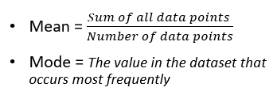
Step 4: Handle missing/NULL values
You can’t ignore missing data because many algorithms will not accept missing values.
There are a couple of ways to deal with missing data:
You can drop records that have missing values - doing this will drop or lose information, so it’s important to be mindful of this before you remove it
Data inference – you can infer a value from another value (e.g. Age from DOB)
Replace NULL values with the mean (average) or replace it with the mode (most repeated value)

Slide 31
Step 5: Normalization
Data normalization is the method of organizing data to appear similar across all records and fields
Usually used when we have values that are very big or very small
One common method to normalize data: Min-max normalization
For every feature, the minimum value of that feature gets transformed into a 0, the maximum value of that feature gets transformed into a 1, and every other value gets transformed into a decimal between 0 and 1.

Slide 32
Step 6: Converting categorical features into numerical values
Categorical features refer to string-type data and can be easily understood by human beings. In the case of machines, they cannot interpret the categorical data directly. Therefore, the categorical data must be translated into numerical data that can be understood by machines
Machine Learning Models can not work on categorical variables, so we need to change it into numerical form.
Most common method:
One-hot encoding: With one-hot, we convert each categorical value into a new categorical column and assign a binary value of 1 or 0 to those columns. Each integer value is represented as a binary vector.
Example:
Assume we have a sequence of labels with the values ‘red’ and ‘green’.
We can assign ‘red’ an integer value of 0 and ‘green’ the integer value of 1. As long as we always assign these numbers to these labels, this is called an integer encoding. Consistency is important so that we can invert the encoding later and get labels back from integer values, such as in the case of making a prediction.
‘red’ , ‘red’ , ‘green’ , ‘red’ ---> 0, 0, 1, 0

Slide 33
Step 7: Validation & QA
Data validation is the final data cleaning technique used to authenticate your data and confirm that it’s high quality, consistent, and properly formatted for downstream processes.
At the end of the data cleaning process, you should be able to answer these questions as a part of basic validation:
Does the data make sense? Do you have enough data for your needs?
Does the data follow the appropriate rules for its field?
Does it prove or disprove your working theory, or bring any insight to light?
Is it uniformly formatted in a design or language that your analysis tools can work with?
Validate that your data is regularly structured and sufficiently clean for your needs. Cross check corresponding data points and make sure nothing is missing or inaccurate.

Slide 34
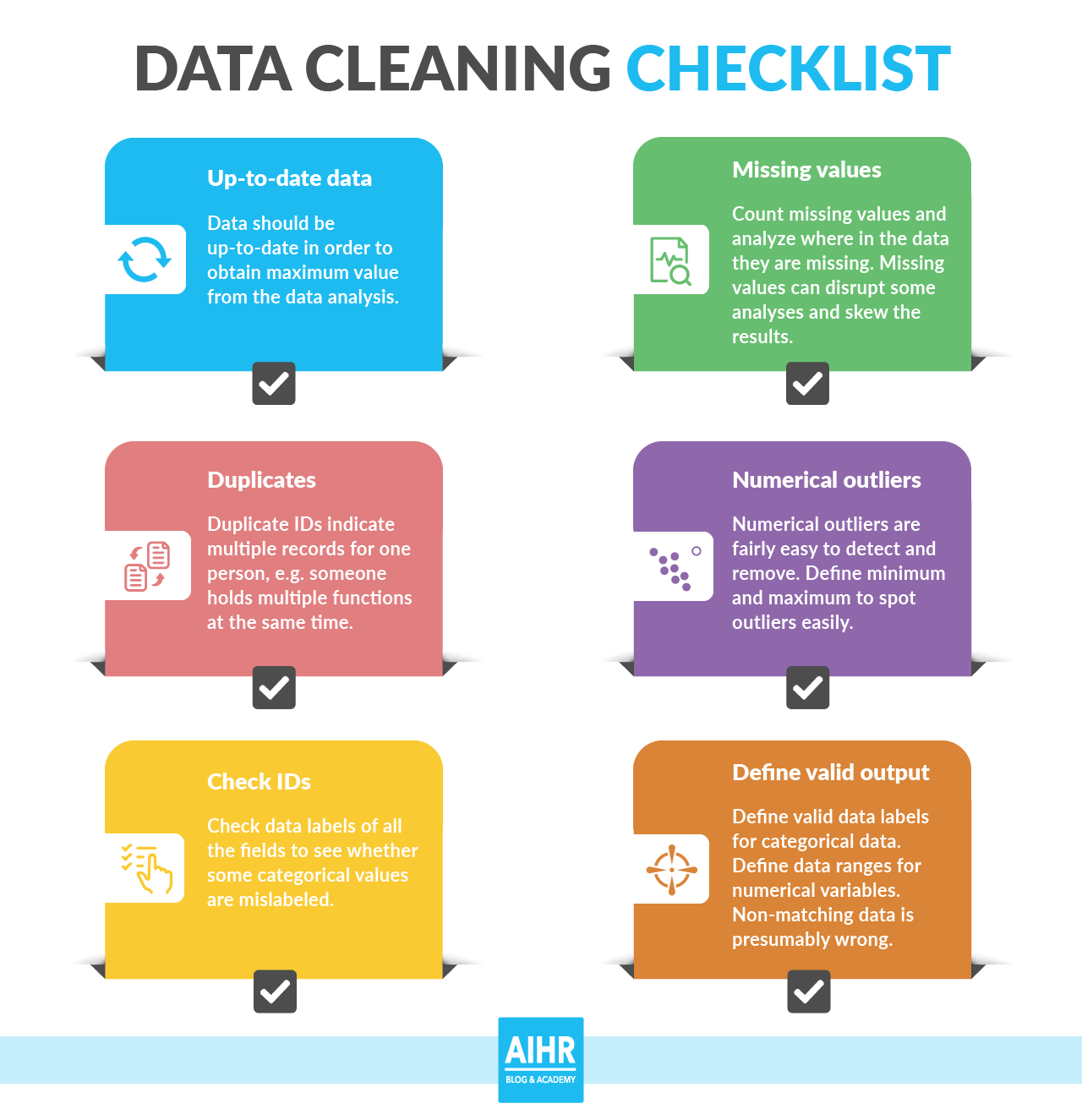

Slide 35


Slide 36
Tips – Data Cleaning

Slide 37
Data Cleaning – Important tips
Create the right process & use it consistently
Pay attention to errors
Use the tools

Slide 38
Create the right process and use it consistently
Set up a data cleaning process that’s right for your data, your needs, and the tools you’ll use for analysis. This is an iterative process, so once you have your specific steps and techniques in place, you’ll need to follow them for all subsequent data and analyses.
It’s important to remember that, although data cleaning may be tedious, it’s vital to your downstream processes. If you don’t start with clean data, you’ll undoubtedly regret it in the future when your analysis produces “garbage results.”

Slide 39
Use tools
There are a number of helpful data cleaning tools you can put to use to help the process – from free and basic, to advanced and machine learning augmented.
Do some research and find out what data cleaning tools are best for you.

Slide 40
Pay attention to errors & track where dirty data comes from
Track and annotate common errors and trends in your data, so you’ll know what kinds of cleaning techniques you need to use on data from different sources.
This will save huge amounts of time and make your data even cleaner – especially when integrating with analysis tools you use regularly.

Slide 41
Example: Medical Insurance cost prediction

Slide 42
Further learning/resources
https://aka.ms/Datacleaningandpreprocessing1
https://aka.ms/Introtopythonindatascience

Slide 43
Recap

Slide 44
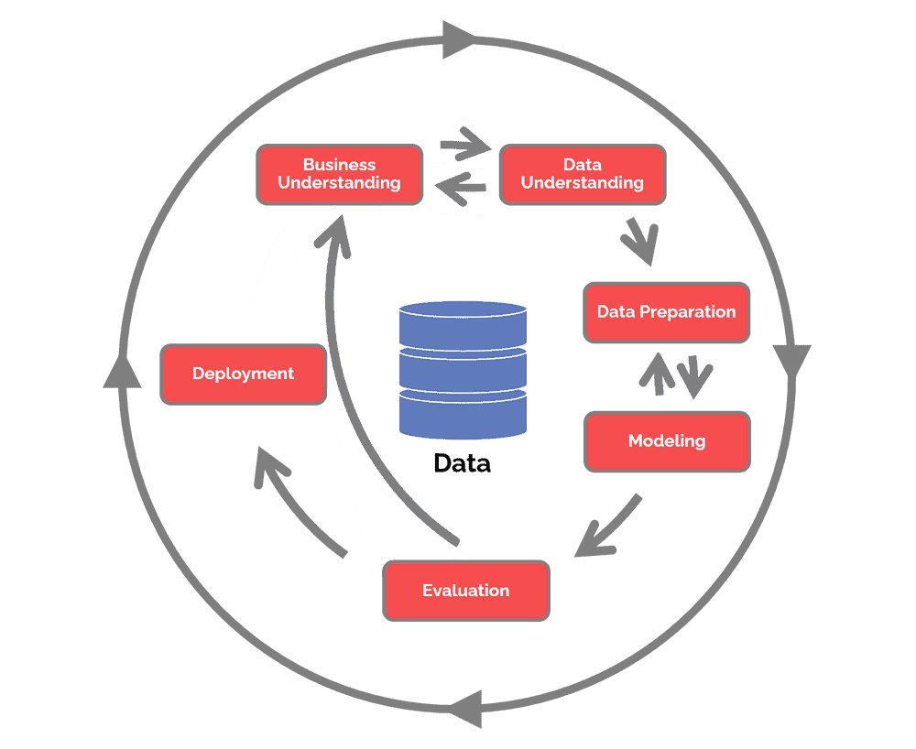

Slide 45
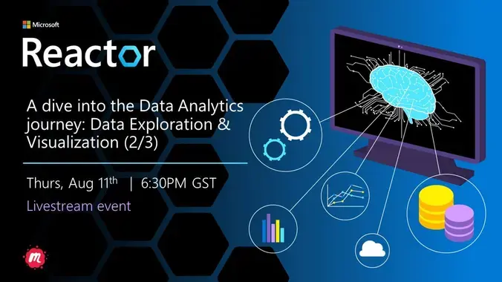

Slide 46


Thank You!
meetup.com/pro/microsoft-reactor/
@MSFTReactor
https://aka.ms/ReactorYouTube
aka.ms/ReactorEmailSignUp
https://www.meetup.com/pro/microsoft-reactor/

